Slide 1

Predict Clinical Insomnia Among Cancer Survivors Using Machine Learning Approaches
Yangxin Fan, Chuqin Wu
Goergen Institute for Data Science
Supervised by: Huiwen Xu, PhD, Po-Ju Lin, PhD

Slide 2
Part 1: Introduction
1.1: Study Aims
1.2: Methods
Part 2: Descriptive analysis
2.2: Predictors
2.3: Correlation analysis
2.4: Patient-symptom network
Part 3: Machine Learning models
3.1: Data preprocessing
3.2: Feature selection
3.3: Regression models
Part 4: Conclusions
3.4: Classification models
2.1: ISI distribution

Slide 3
1.1: Study Aims
Process baseline data of YOCAS II randomized controlled trial among 740 cancer survivors;
Develop Machine Learning models to predict ISI (Insomnia severity index) and classify severe Insomnia (ISI >= 19);
Provide clinically meaningful interpretation.

Slide 4
1.2: Methods
Baseline data from Yoga for Cancer Survivors (YOCAS©®)
Sample size 615 cancer survivors with complete data.
Linear Outcome: Insomnia Severity Index (range: 0-28)
Binary Outcome of severe Insomnia: Cutoff: 19
45 predictors in total:
demographics: age, gender, race, employment etc.
clinical characteristics: cancer type etc.
symptoms: pain, fatigue, depression etc.
objective physical measures: BMI, distance from 6 minutes walk test, handgrip strength etc.
Notes:
Add
Add Clinical characteristics
Four tables show each predictors category

Slide 5
1.2: Methods
Methods used in regression: XGBoost, AdaBoost, Random Forests, Neural Networks, LASSO Regression, KNN Regression, Linear Regression (baseline)
Methods used in binary classification: Logistic Regression, XGBoost, Random Forests
Metrics for model performance evaluation: test RMSE (Root Mean Square Error), test MAE (Mean Absolute Error), R square, and adjusted R square.
Notes:
Add
Add Clinical characteristics
Four tables show each predictors category

Slide 6
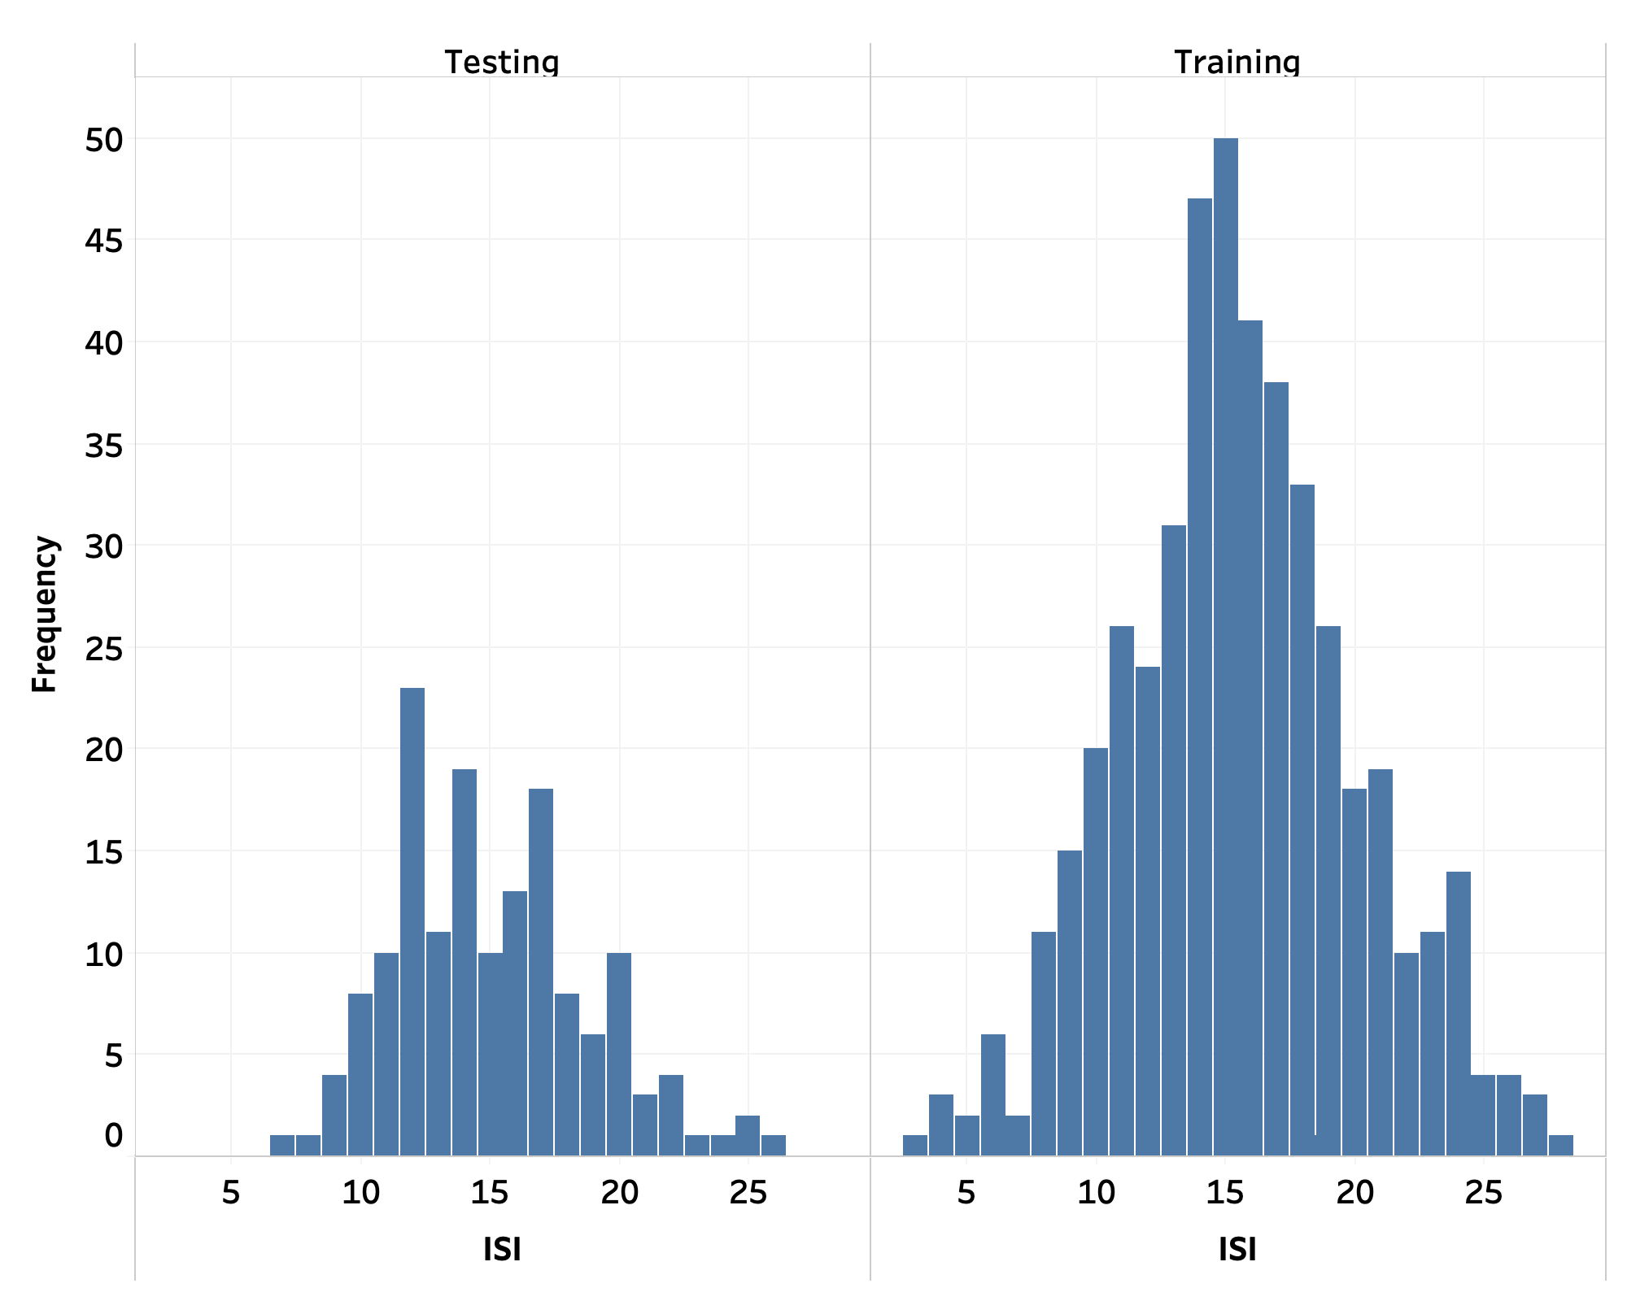
2.1: ISI Distribution (continuous)
Train Test Split:
train: 75% (461)
test: 25% (154)
P-value: 0.193 > 0.05
No significant difference between train and test ISI distribution
Notes:
Add
Add Clinical characteristics
Four tables show each predictors category

Slide 7
2.2: Predictors
Notes:
Add
Add Clinical characteristics
Four tables show each predictors category

Slide 8
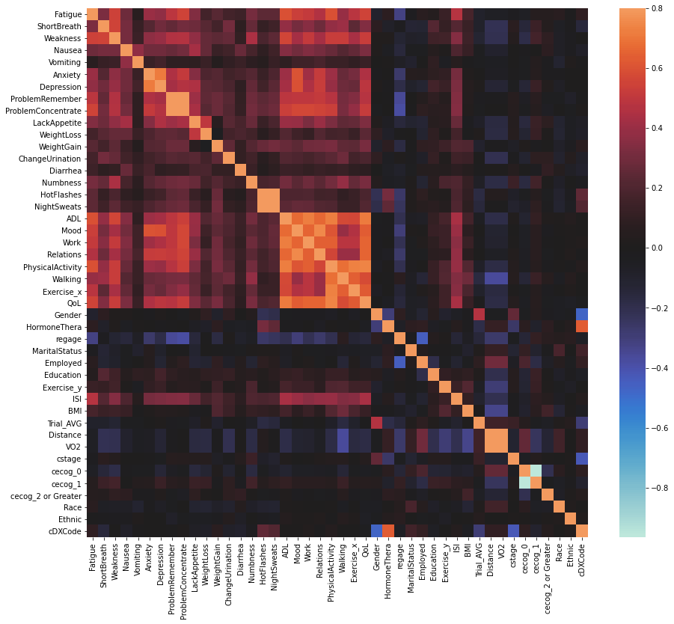
2.3: Correlation analysis
Larger correlation
Features including fatigue, weakness, anxiety, depression, ProblemRemember, ProblemConcentrate, ADL, Mood, Work, Relations, PhysicalActivity, Walking, Exercise_x, and QoL have
relatively large correlation with ISI.
Larger correlation
Notes:
Change low corr color to be light
Darker = Stronger correlation
Fatigue, weakness, anxiety, depression, ProblemRemember, ProblemConcentrate, ADL, Mood, Work, Relations, PhysicalActivity, Walking, Exercise_x, QoL

Slide 9
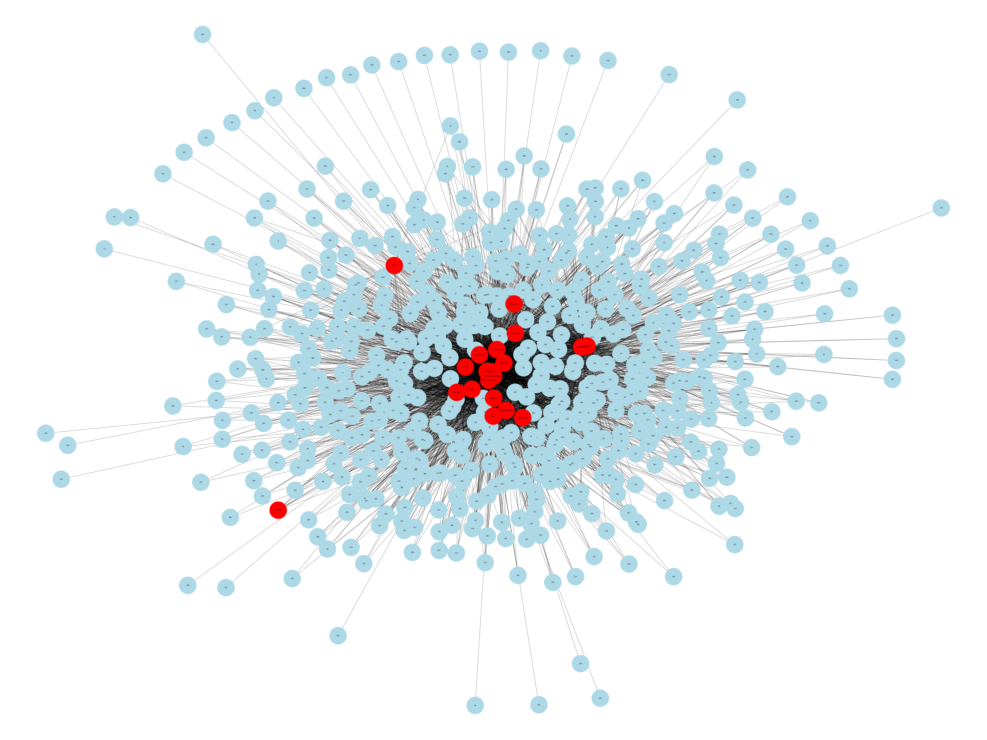
2.4: Patient-symptom network – bipartite graph
Patient-symptom bipartite network: high overlap of 20 symptoms (red nodes) across 577 patients (blue nodes). A large cluster of symptoms locates in the center of the network while a few symptoms that are off-center (Vomiting and Diarrhea). This network structure is to a similar study conducted by [4]
Notes:
Split it to three slides
38 out of 615 patients do not have any symptoms so they are excluded.
[4]: Bhavnani, Suresh K., et al. "The nested structure of cancer symptoms: implications for analyzing co-occurrence and managing symptoms." Methods of information in medicine 49.6 (2010): 581.

Slide 10
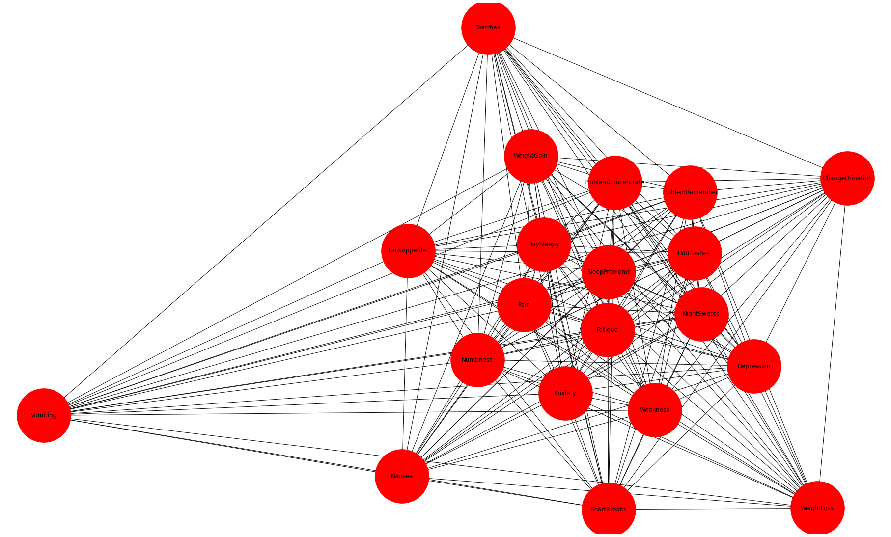
2.4: Patient-symptom network - projection
This is the weighted-projection of the bipartite network. Edge weight is the ratio between actual shared neighbors and maximum possible shared neighbors (i.e., the size of the other node set).
Notes:
Split it to three slides
38 out of 615 patients do not have any symptoms so they are excluded.
[4]: Bhavnani, Suresh K., et al. "The nested structure of cancer symptoms: implications for analyzing co-occurrence and managing symptoms." Methods of information in medicine 49.6 (2010): 581.

Slide 11
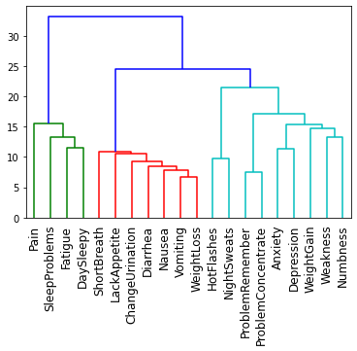
2.4: Patient-symptom network – hierarchical clustering
Hierarchical Clustering of symptoms. The symptoms close in bipartite network projection turn to be clustered together.
The optimal number of clusters = 3, see color of the left plot.

Slide 12
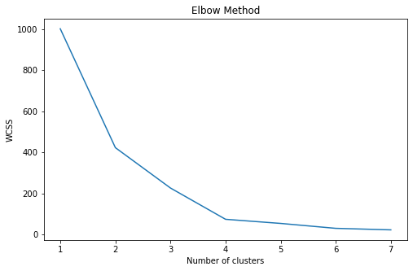
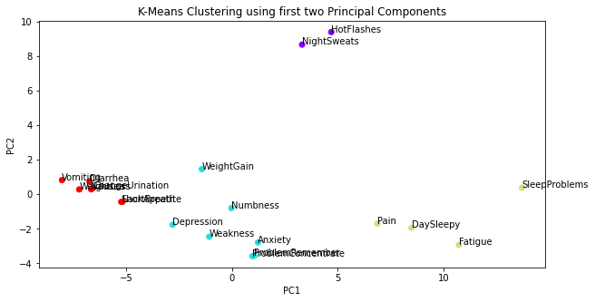
2.4: Patient-symptom network – k-means clustering
K-Means Clustering of symptoms using first two principal components from PCA. Using Elbow method, we find the optimal # clusters = 4, see above.

Slide 13
3.1: Data preprocessing
Train test split: train: 75%, test: 25%
Data cleaning: use two imputation methods: MICE Imputation [1] and KNN imputation [2] to fill in missing values
Data transformation: use z-score normalization to normalize training data first and then use same mean and variance to normalize testing data (avoiding data leaking issue)
Notes:
[1]: Van Buuren, Stef, and Karin Oudshoorn. Flexible multivariate imputation by MICE. Leiden: TNO, 1999.
[2]: Zhang, Shichao. "Nearest neighbor selection for iteratively kNN imputation." Journal of Systems and Software 85.11 (2012): 2541-2552.

Slide 14
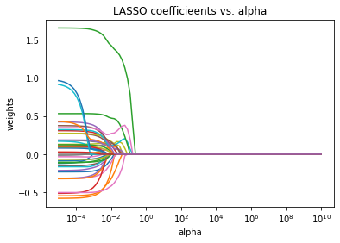
3.2: Feature Selection
Using Embedded feature selection method LASSO
LASSO can train models and select most relevant features together
Selected 12 relevant features (coefficient not 0) include: Fatigue, Depression, LackAppetite, HotFlashes, NightSweats, ADL, Relations, Walking, Exercise_x, QoL, Employed, Distance.
10 out of 12 features are from symptoms dataset.
Notes:
Note: We also tried Recursive Feature Elimination (RFE) for Feature Selection. But it does give worse performance than LASSO in test dataset.

Slide 15
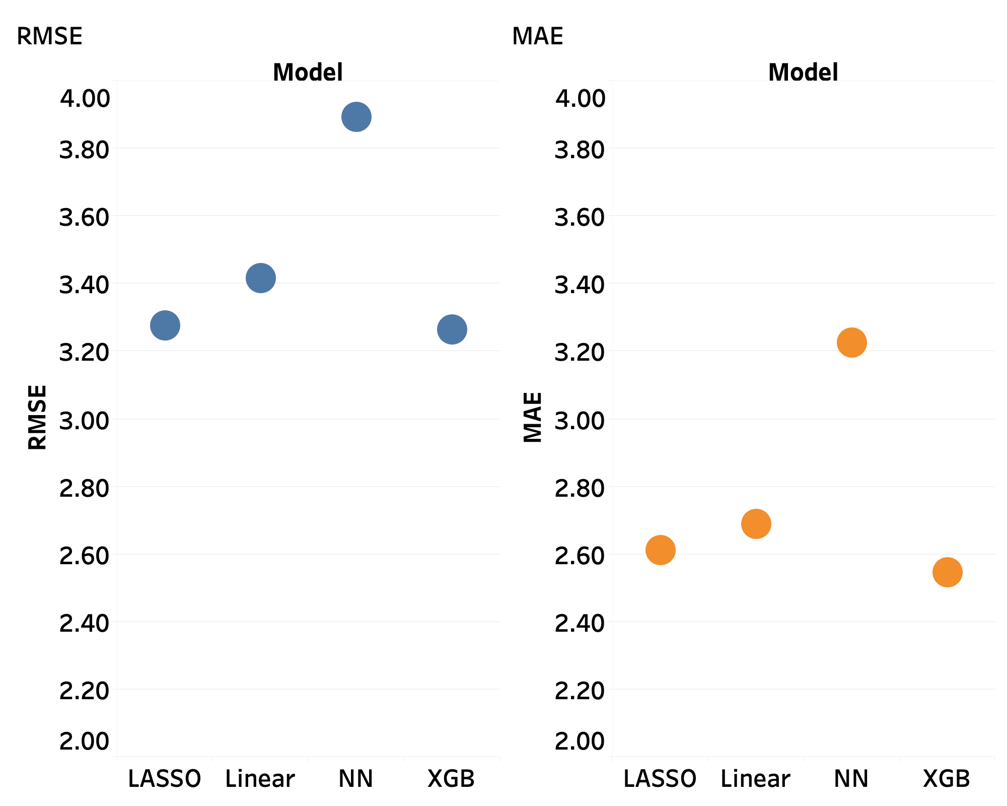
3.3: Regression - Compare Model Performances
In total, we built eight regression models to predict ISI (Insomnia severity index). Their performance cross test MAE and RMSE is shown are shown in the left plot.
In terms of RMSE and MAE, XGBoost performs best followed closely by LASSO. Both have less than 3.3 test RMSE
The lower the better
RMSE vs. models & MAE vs. models
Notes:
Make fonts 20
Note:
results shown here are trained using the complete feature set except RFE (it is RFE with Linear SVMs)
All models are trained in our project using five-fold cross validation for hyper-parameters tuning

Slide 16
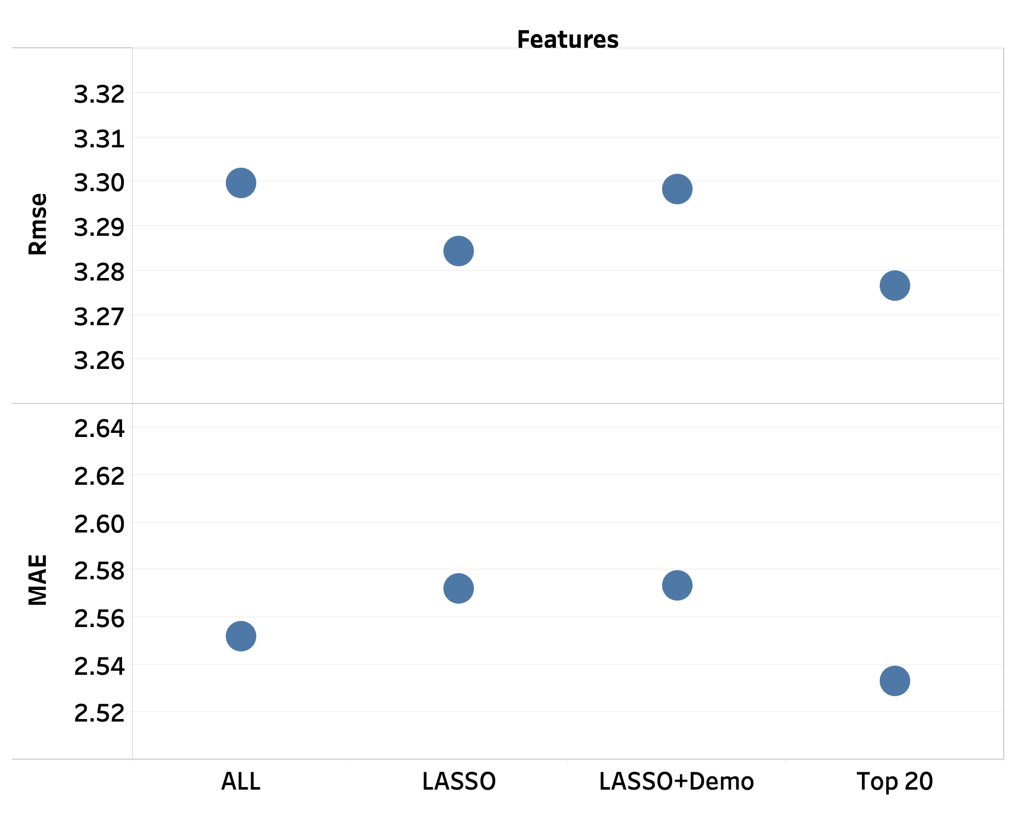
3.3: Regression - XGBoost with different predictors combination
Since XGBoost models perform the best when using the complete set of features, we explored different combination of features to find the best model
In terms of RMSE and MSE, XGBoost with top 20 most important features from XGBoost is the best
The lower the better
Notes:
Since XGBoost and LASSO models perform the best when using the complete set of features, we explored different combination of features to find the best model (see the left plot)
In terms of RMSE and MSE, XGBoost with top 20 most important features from XGBoost is the best
In terms adjusted R square, XGBoost with features selected by LASSO is the best
Split to two slides to test performance using different indicators
We tried the below different combinations of features
1. keep all (default)
2. Select features from non-zero Lasso coefficients
3. Select features from Lasso + Key social/demographics
4. Top 20 most important features from XGBoost
Key social/demographics include: ‘regage','Race','Ethnic','Gender','MaritalStatus','Education','BMI','cDXCode','cecog_0','cecog_1','cecog_2 or Greater'

Slide 17
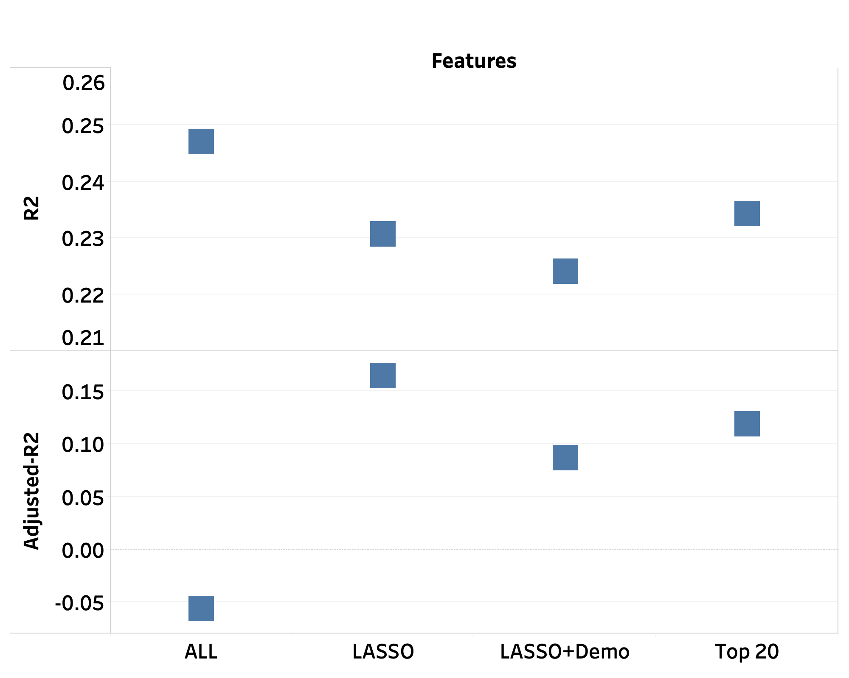
3.3: Regression - XGBoost with different predictors combination
In terms of the adjusted R square, XGBoost with features selected by LASSO is the best. It may be because of only using 12 predictors selected by LASSO
The higher the better

Slide 18
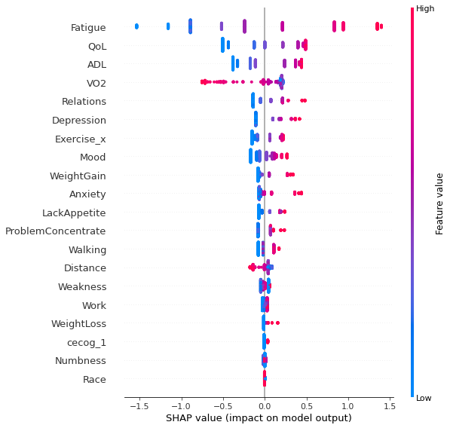
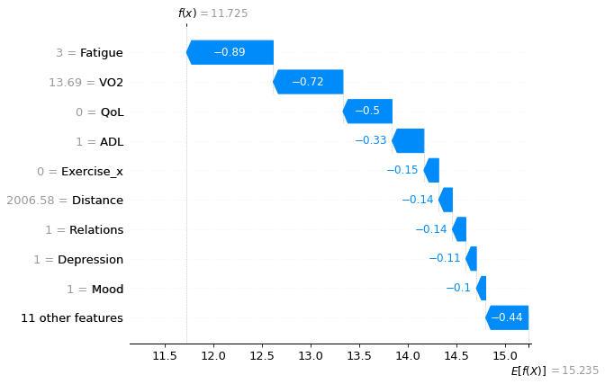
3.3: Regression – XGBoost with top 20 explanation
How predictors influence prediction
Top 20 features from XGBoost
Notes:
Top 20 most important features from XGBoost
Similar to LASSO, most important features come from Symptom dataset
8 out of top 20 features are also selected by LASSO, including Fatigue, Depression, LackAppetite, ADL, Relations, Walking, Exercise_x, QoL, and Distance

Slide 19
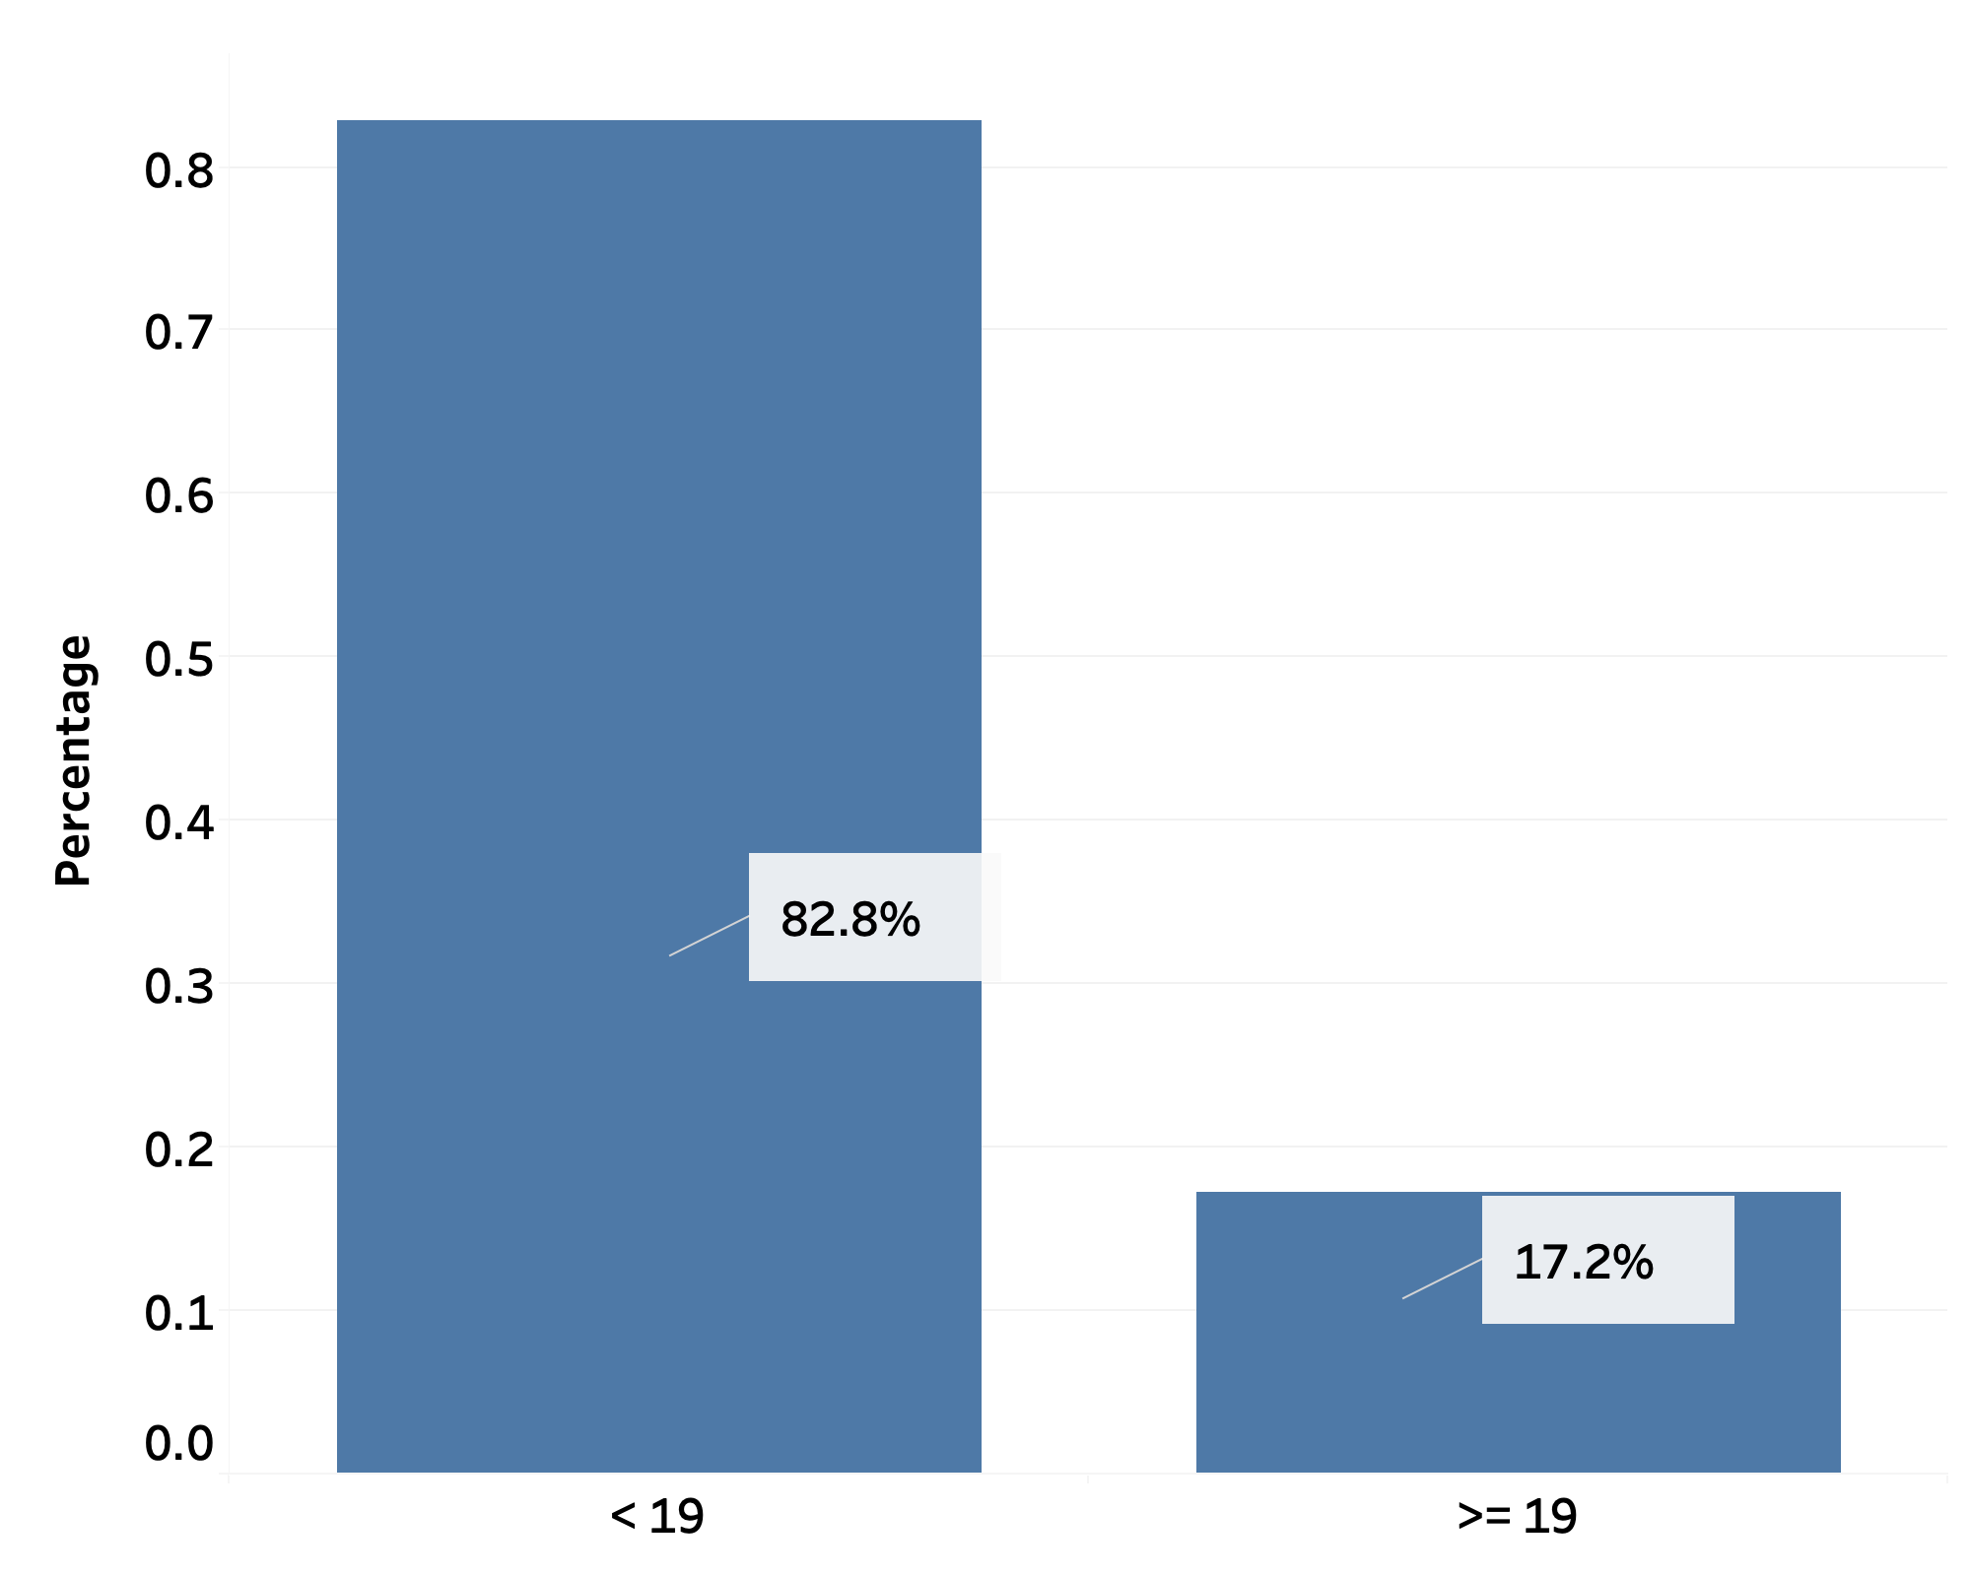
3.4: Classification models
Due to huge data imbalance when setting ISI =10 as cutting point, SMOTE [3] resampling failed to mitigate this issue. We use cutting point ISI = 19
Below 19: moderate
Above 19: severe
Goal: to build classification models with high F1 score
Data imbalance in YOCAS RCT dataset
Notes:
Note:
1. Both 11 and 19 are clinically meaningful cutting points. Since 11 give us worse performance, wee choose 19 as the cutting point.
2. 7.4797% less than 11
3. 17.2358% larger than 19
[3]: Chawla, Nitesh V., et al. "SMOTE: synthetic minority over-sampling technique." Journal of artificial intelligence research 16 (2002): 321-357.

Slide 20
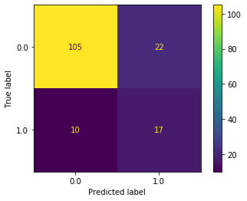
3.4: Classification models
We built twelve models, including three algorithms logistic regression, Random Forests, XGBoost and four different sets of features (full, LASSO features, LASSO features + key social/demographics, XGBoost top 20 features)
Best Model with highest weighted F1 score 0.81: Logistic regression with features selected by LASSO.
Confusion matrix of testing set
Notes:
Note:
1. Both 11 and 19 are clinically meaningful cutting points. Since 11 give us worse performance, wee choose 19 as the cutting point.
2. 7.4797% less than 11
3. 17.2358% larger than 19
4. Key social/demographics include: ‘regage','Race','Ethnic','Gender','MaritalStatus','Education','BMI','cDXCode','cecog_0','cecog_1','cecog_2 or Greater'

Slide 21
4: Conclusions
Best regression model: XGBoost using top 20 features
Best classification model: Logistic regression using features selected by LASSO
Patient - symptoms network analysis reveals structures of frequent symptoms
Most symptoms always appear together with others while a few outlier symptoms (vomiting and diarrhea) are off-center
Feature importance analysis help us to identify most relevant features for predicting insomnia severity index:
Top five: Fatigue, Depression, QoL, Exercise_x (add explanation), ADL
Most of important features are mainly from symptoms and objective physical measures datasets. Hence, these features may be more clinically meaningful for Insomnia research
Notes:
A large cluster of symptoms locates in the center of the network while a few symptoms that are off-center (Vomiting and Diarrhea)

Slide 22
5: References
[1]: Van Buuren, Stef, and Karin Oudshoorn. Flexible multivariate imputation by MICE. Leiden: TNO, 1999.
[2]: Zhang, Shichao. "Nearest neighbor selection for iteratively kNN imputation." Journal of Systems and Software 85.11 (2012): 2541-2552.
[3]: Chawla, Nitesh V., et al. "SMOTE: synthetic minority over-sampling technique." Journal of artificial intelligence research 16 (2002): 321-357.
[4]: Bhavnani, Suresh K., et al. "The nested structure of cancer symptoms: implications for analyzing co-occurrence and managing symptoms." Methods of information in medicine 49.6 (2010): 581.

Slide 23

Q & A
Notes:
Q&A / Thanks

